Slide 1
Covid-19 Vaccines Analysis
Phase-4

Slide 2
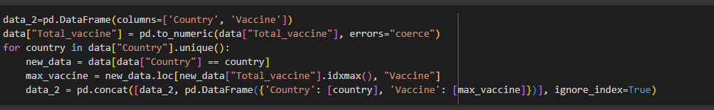
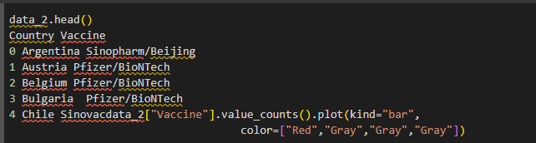
Most commonly used vaccines in countries

Slide 3
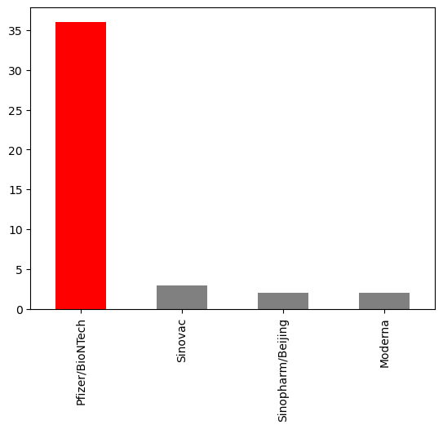

Slide 4
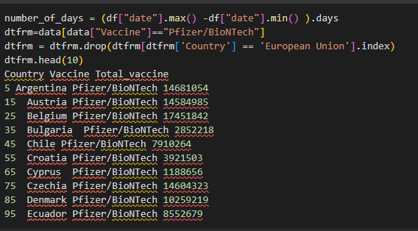
Average daily vaccination count in countries

Slide 5
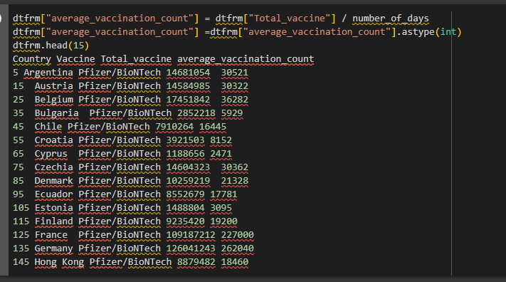

Slide 6


Slide 7
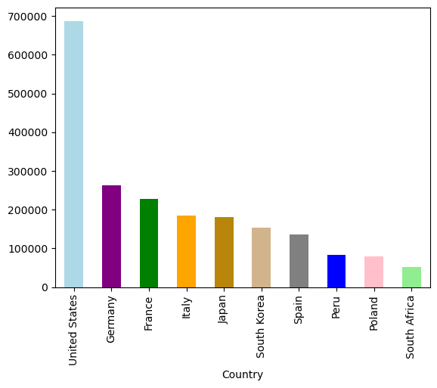

Slide 8

Number of countries where vaccines are used

Slide 9
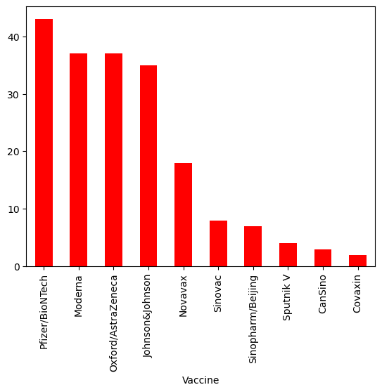

Slide 10
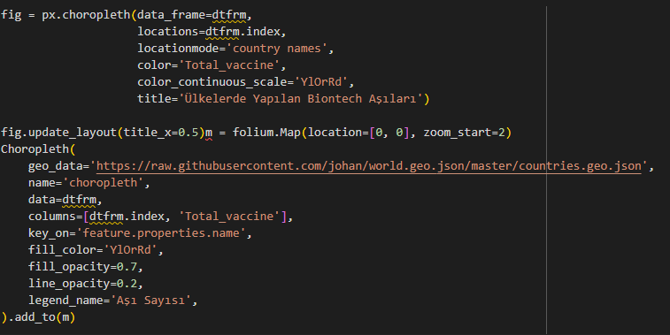
Choropleth map of the most used vaccine

Slide 11
